Slide 1
Traffic Survey 3rd – 12th March 2025
Summary Findings
Site Location | Direction | Start Date | End Date | Posted Speed Limit (PSL) | Total Vehicles | Mean Speed | 85th %ile Speed | 24-hour 5-day Average Flow | 12-hour 7-day Average Flow | 24-hour 7-day Average Flow | % Heavies (inc. buses)
Unnamed Road between Pound Lane (W) and Sandy Lane (E) | Eastbound | Mon 03/03/2025 | Wed 12/03/2025 | 20mph | 11697 | 26.69 | 31.57 | 1405 | 1217 | 1371 | 3.94%
Unnamed Road between Sandy Lane (E) and Pound Lane (W) | Westbound | Mon 03/03/2025 | Wed 12/03/2025 | 20mph | 11230 | 26.12 | 31.13 | 1383 | 1188 | 1329 | 4.03%
Flow Reporting
Uphill
Downhill

Slide 2
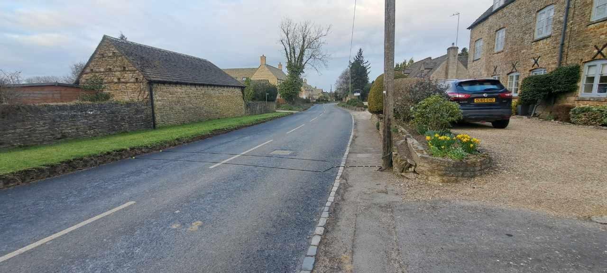
5-day AM Peak Ave Flow - 379
5-day AM Peak Speed (mph) - Mean 26 / 85th%ile 31.22
5-day PM Peak Ave Flow - 312
5-day PM Peak Speed (mph) - Mean 25.83 / 85th%ile 30.53
5-day Average Weekday Heavies % - 4.9%
5-day AM Peak Ave Flow - 284
5-day AM Peak Speed (mph) - Mean 26.53 / 85th%ile 31.63
5-day PM Peak Ave Flow - 370
5-day PM Peak Speed (mph) - Mean 26.37 / 85th%ile 31.13
5-day Average Weekday Heavies % - 3.9%

Slide 3
Traffic Count Summary – highlighting peaks
 | Monday | Tuesday | Wednesday | Thursday | Friday | Saturday | Sunday | Monday | Tuesday | Wednesday | Thursday | Friday | Saturday | Sunday | 3-day Average (Tue-Thur) | 5-day Average (Mon-Fri) | 7-day Average (Mon-Sun)
Hour Starting | 03/03/2025 | 04/03/2025 | 05/03/2025 | 06/03/2025 | 07/03/2025 | 08/03/2025 | 09/03/2025 | 10/03/2025 | 11/03/2025 | 12/03/2025 | 13/03/2025 | 14/03/2025 | 15/03/2025 | 16/03/2025
00:00 | * | 3 | 3 | 7 | 12 | 6 | 10 | 1 | 5 | 17 | * | * | * | * | 7 | 7 | 7
01:00 | * | 4 | 1 | 2 | 0 | 2 | 3 | 2 | 5 | 3 | * | * | * | * | 3 | 2 | 2
02:00 | * | 3 | 2 | 2 | 1 | 1 | 1 | 0 | 3 | 4 | * | * | * | * | 3 | 2 | 2
03:00 | * | 0 | 1 | 0 | 4 | 2 | 0 | 1 | 2 | 3 | * | * | * | * | 1 | 2 | 1
04:00 | * | 2 | 1 | 3 | 3 | 0 | 0 | 1 | 3 | 4 | * | * | * | * | 3 | 2 | 2
05:00 | * | 6 | 14 | 11 | 6 | 5 | 2 | 7 | 9 | 14 | * | * | * | * | 11 | 10 | 8
06:00 | * | 60 | 59 | 59 | 45 | 33 | 10 | 62 | 70 | 50 | * | * | * | * | 60 | 58 | 50
07:00 | * | 168 | 181 | 174 | 161 | 47 | 32 | 160 | 171 | * | * | * | * | * | 174 | 169 | 137
08:00 | * | 314 | 295 | 330 | 283 | 112 | 90 | 298 | 341 | * | * | * | * | * | 320 | 310 | 258
09:00 | * | 173 | 173 | 197 | 187 | 203 | 112 | 188 | 187 | * | * | * | * | * | 183 | 184 | 178
10:00 | * | 177 | 172 | 158 | 188 | 250 | 212 | 140 | 157 | * | * | * | * | * | 166 | 165 | 182
11:00 | * | 173 | 165 | 167 | 174 | 270 | 193 | 163 | 164 | * | * | * | * | * | 167 | 168 | 184
12:00 | * | 182 | 150 | 165 | 165 | 288 | 221 | 155 | 171 | * | * | * | * | * | 167 | 165 | 187
13:00 | * | 185 | 172 | 181 | 154 | 255 | 214 | 160 | 155 | * | * | * | * | * | 173 | 168 | 185
14:00 | * | 188 | 169 | 203 | 194 | 242 | 222 | 168 | 153 | * | * | * | * | * | 178 | 179 | 192
15:00 | 259 | 287 | 284 | 294 | 277 | 237 | 223 | 276 | 258 | * | * | * | * | * | 281 | 276 | 266
16:00 | 266 | 272 | 248 | 254 | 253 | 220 | 177 | 265 | 268 | * | * | * | * | * | 261 | 261 | 247
17:00 | 244 | 268 | 255 | 296 | 244 | 190 | 161 | 235 | 254 | * | * | * | * | * | 268 | 257 | 239
18:00 | 172 | 173 | 153 | 179 | 159 | 120 | 87 | 148 | 169 | * | * | * | * | * | 169 | 165 | 151
19:00 | 99 | 112 | 113 | 130 | 85 | 84 | 59 | 97 | 102 | * | * | * | * | * | 114 | 105 | 98
20:00 | 54 | 66 | 56 | 82 | 47 | 37 | 31 | 62 | 73 | * | * | * | * | * | 69 | 63 | 56
21:00 | 33 | 33 | 44 | 46 | 34 | 33 | 26 | 33 | 30 | * | * | * | * | * | 38 | 36 | 35
22:00 | 13 | 15 | 26 | 32 | 30 | 31 | 15 | 9 | 29 | * | * | * | * | * | 26 | 22 | 22
23:00 | 6 | 6 | 5 | 12 | 28 | 17 | 5 | 7 | 19 | * | * | * | * | * | 11 | 12 | 12
Summary Data |  |  |  |  |  |  |  |  |  |  |  |  |  |  | Summary Data
0700-1900 | 941 | 2560 | 2417 | 2598 | 2439 | 2434 | 1944 | 2356 | 2448 | 0 | 0 | 0 | 0 | 0 | 2506 | 2467 | 2404
0600-2200 | 1127 | 2831 | 2689 | 2915 | 2650 | 2621 | 2070 | 2610 | 2723 | 50 | 0 | 0 | 0 | 0 | 2787 | 2729 | 2643
0600-0000 | 1146 | 2852 | 2720 | 2959 | 2708 | 2669 | 2090 | 2626 | 2771 | 50 | 0 | 0 | 0 | 0 | 2823 | 2763 | 2677
0000-0000 | 1146 | 2870 | 2742 | 2984 | 2734 | 2685 | 2106 | 2638 | 2798 | 95 | 0 | 0 | 0 | 0 | 2851 | 2788 | 2700
0700-1000 | 0 | 655 | 649 | 701 | 631 | 362 | 234 | 646 | 699 | 0 | 0 | 0 | 0 | 0 | 676 | 664 | 572
1600-1900 | 682 | 713 | 656 | 729 | 656 | 530 | 425 | 648 | 691 | 0 | 0 | 0 | 0 | 0 | 697 | 682 | 637
Peak Hour Analysis |  |  |  |  |  |  |  |  |  |  |  |  |  |  | Peak Hour Analysis
07:00-10:00 | 0 | 314 | 295 | 330 | 283 | 203 | 112 | 298 | 341 | 0 | 0 | 0 | 0 | 0 | 320 | 310 | 258
10:00-16:00 | 259 | 287 | 284 | 294 | 277 | 288 | 223 | 276 | 258 | 0 | 0 | 0 | 0 | 0 | 281 | 276 | 266
16:00-19:00 | 266 | 272 | 255 | 296 | 253 | 220 | 177 | 265 | 268 | 0 | 0 | 0 | 0 | 0 | 268 | 261 | 247
Note: Peak Hour Analysis calculates and then highlights the highest flow within the period listed

Slide 4
Mean Speeds & Average Flows
Uphill
Downhill

